Slide 1

Low Frequency Systematic Signal for Real-Estate Investments in NYC
Notes:
Over the last 24 hours, we developed a low frequency systematic signal for real-estate investment in New York City. Now, we had a lot of fun just identifying unique trends in the data and finding correlation between seemingly independent variables, but we wanted to take it one step further. We wanted to find a way to exploit the patterns we found– because that’s at the heart of how Cubist generates alpha.

Slide 2

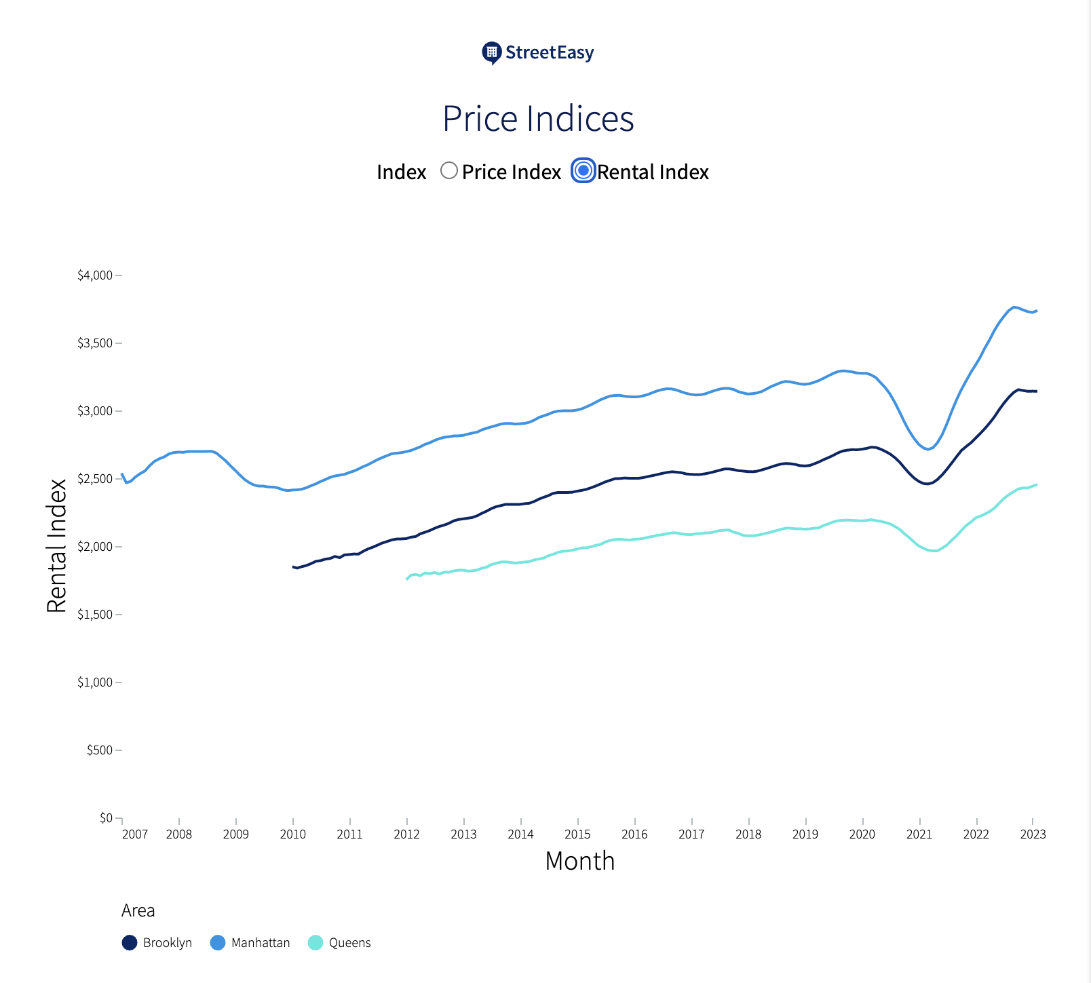
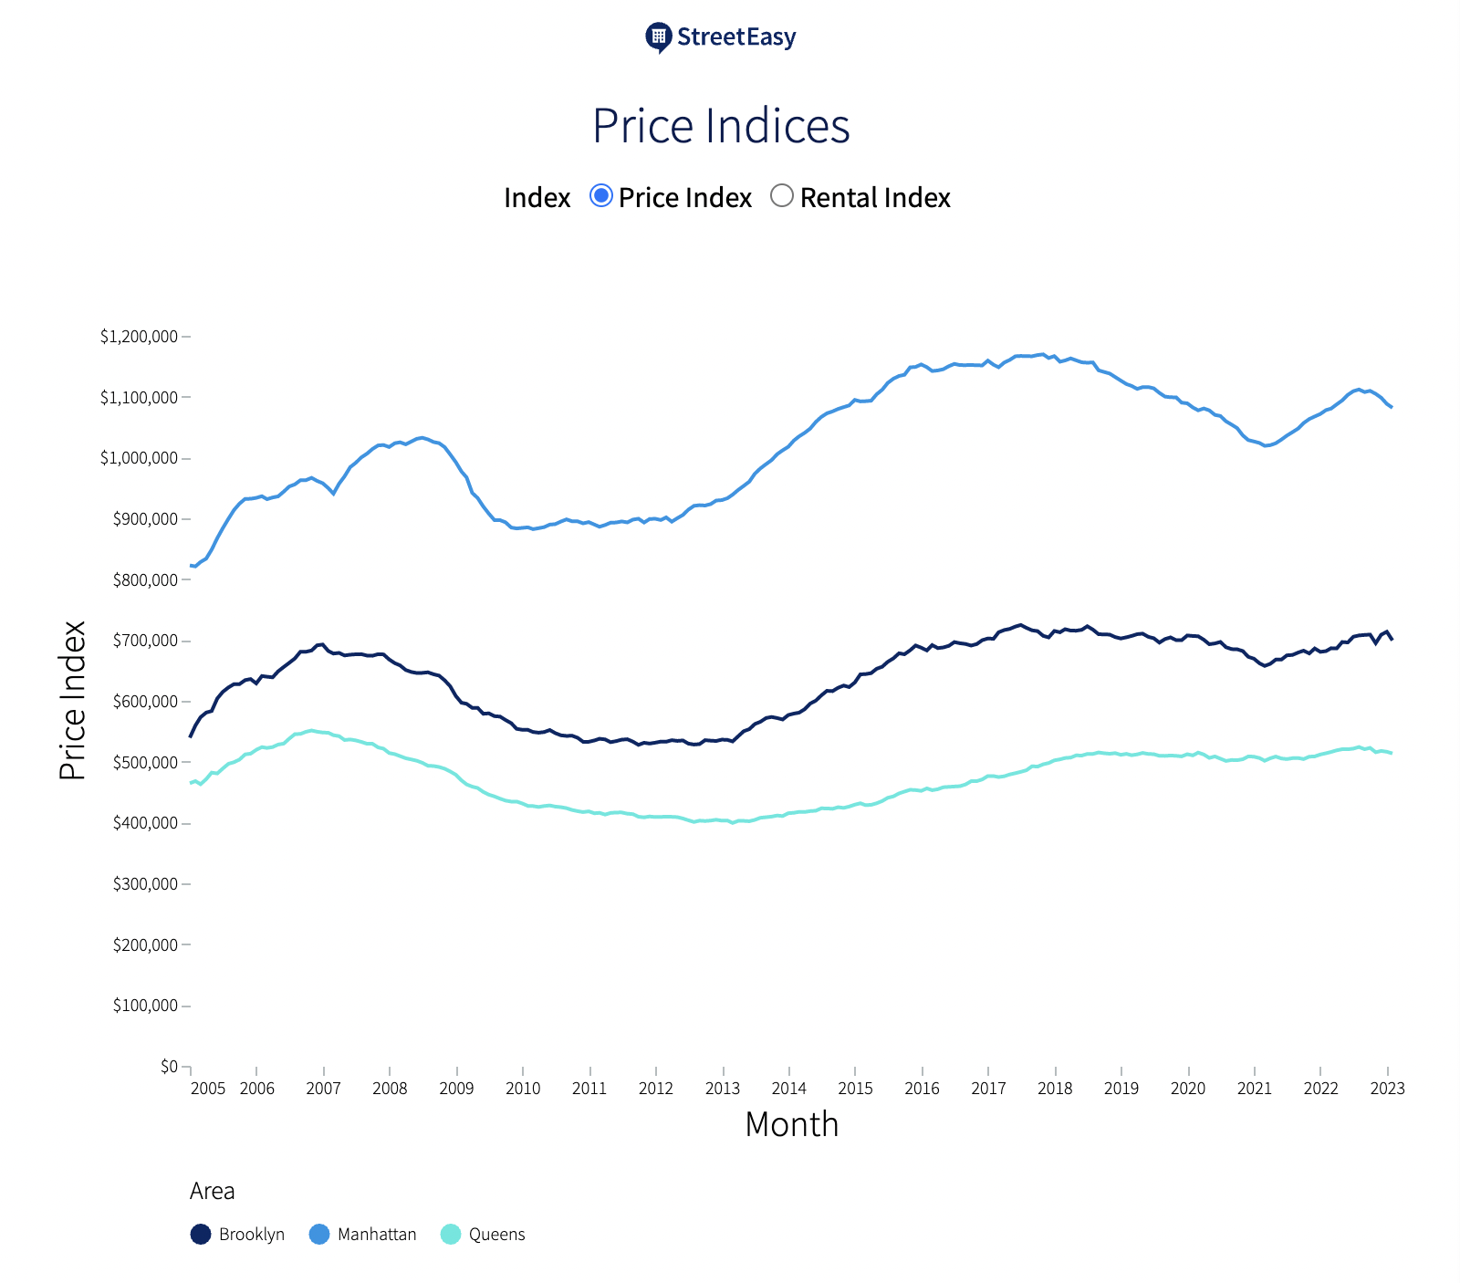
Real Estate in New York City
As New York City bounces back from COVID-19, former residents are moving back, tourists are traveling again, & the real estate market is returning to pre-pandemic prices.
Notes:
New York is currently bouncing back from Covid, and the real-estate market is primed to continue to grow. Which we think makes it a great market to invest in.

Slide 3



Data
311 Service Requests 2010-Present
Tree Census Data 2015
NYC Restaurant Inspection Results
Notes:
So the goal was to find some combination of variables across three very distinct and unique data sets, that would serve as a signal for appreciation in real estate value. We looked at variables from the 311 service request, tree census, and restaurant inspection datasets. Broadly speaking, we’re trying to find a good investment.

Slide 4
Intuition for Signal
Trees Affect Value of Urban Land
USDA Forest Service has developed a foundation for valuing trees as a structural asset in greater-NYC-metro area & goes in depth on how the loss of a single tree can cost a homeowner based on size, age, and species of tree
David, J. Nowak. "Compensatory value of urban trees in the United States." Journal of Arboriculture 28.40 (2002): 194-199.
Restaurants Affect Value of Urban Land
UCLA white paper on predicting real estate value using restaurant data in 9 chinese cities indicates a strong correlation between the two
Dong, Lei, Carlo Ratti, and Siqi Zheng. "Predicting neighborhoods’ socioeconomic attributes using restaurant data."
311’s Positive Correlation with Value of Urban Land
Despite what may seem intuitive, there is a slight positive correlation between value of land and 311 requests – “For instance, an individual accustomed to seeing rodents in their building may be less likely to complain than someone seeing a rodent in their apartment for the first time”
Kontokosta, Constantine E., and Boyeong Hong. "Bias in smart city governance: How socio-spatial disparities in 311 complaint behavior impact the fairness of data-driven decisions."

Slide 5
Approach
Blend 30-Day Moving Averages of 311 Request frequency & Restaurant Inspection scores scaled by 2015 Tree Census steward scores times overall tree health
Restaurant Inspection Scores & 311 Service Requests are weighted 70/30
Tree Scaling factor exaggerates extrema by 20% & normalizes internal scores
70%
30%
-20%
+20%

Slide 6
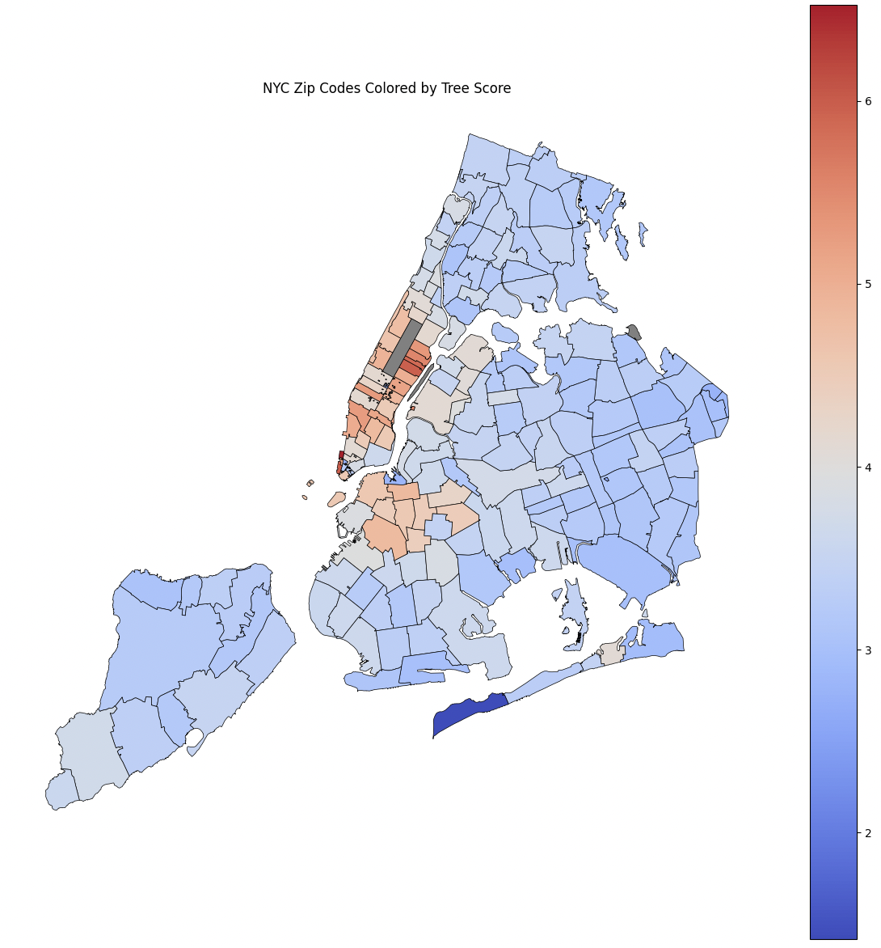
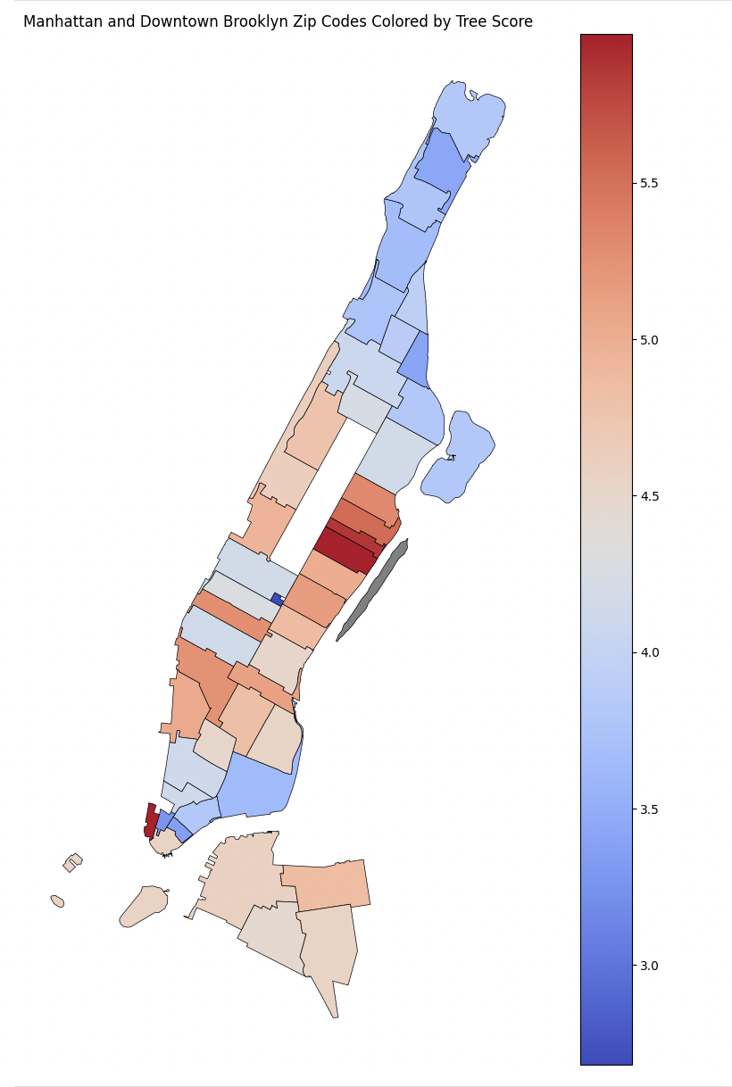
Tree-Score Heat Map
Note: distribution is right skew
Notes:
Tree score: attempt of quantifying the evidence of someone taking care of tree (census ranking between 4 categories)
Be more indicative of nicer residential areas where public cleanliness is actively maintained
maps created using a shp nyc shapefile
geopandas and matplotlib

Slide 7
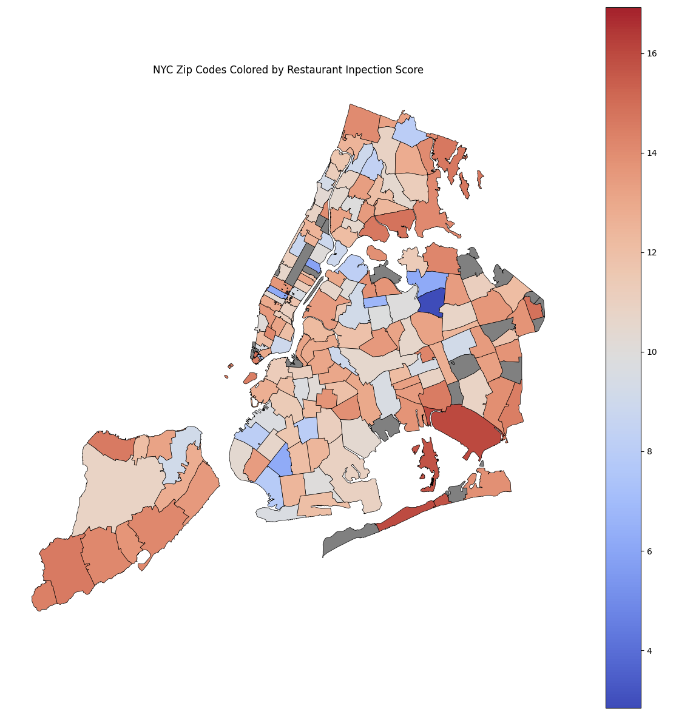
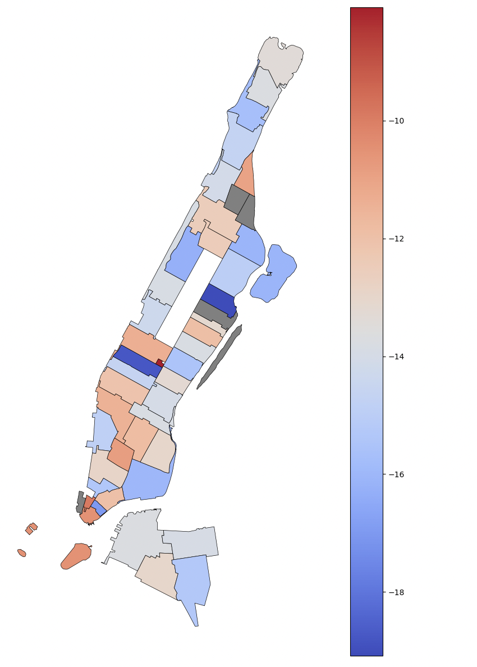
Restaurant-Score Heat Map
Note: distribution is left skew

Slide 8
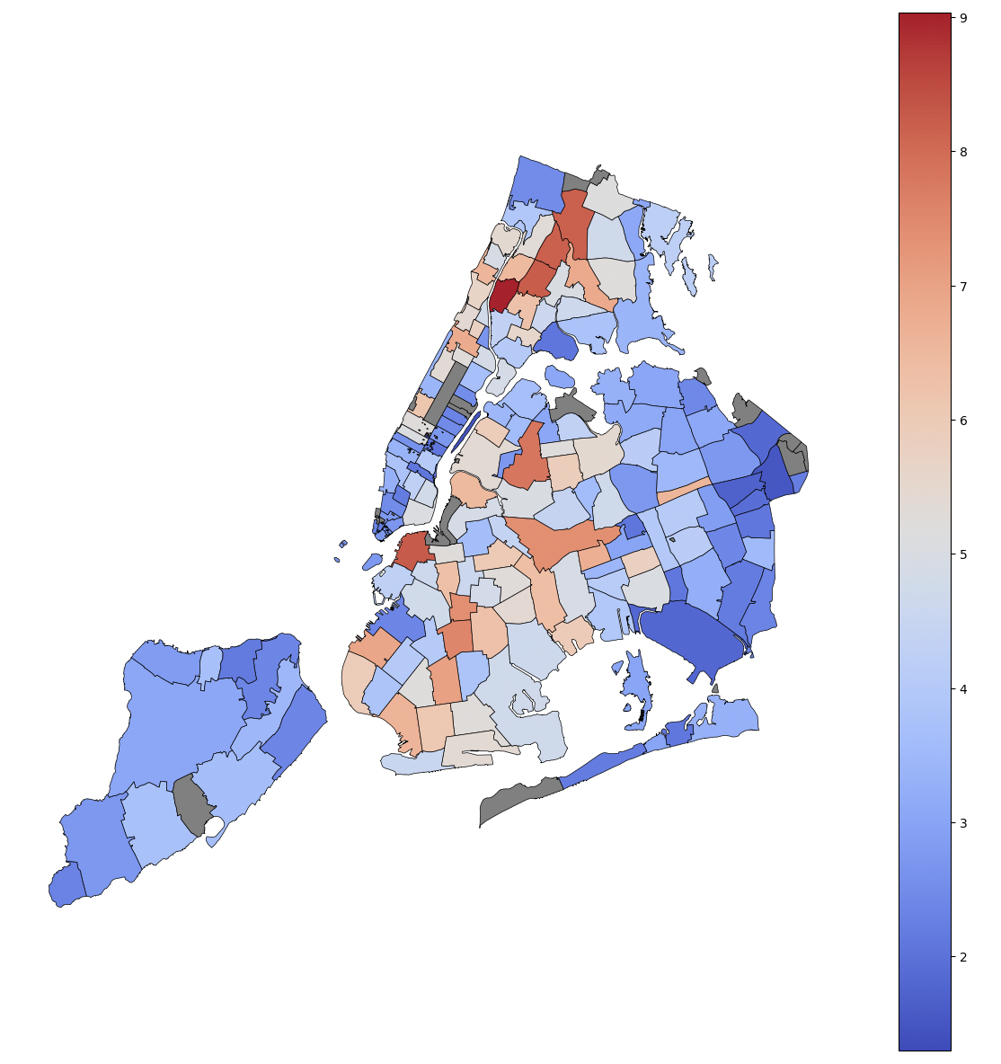
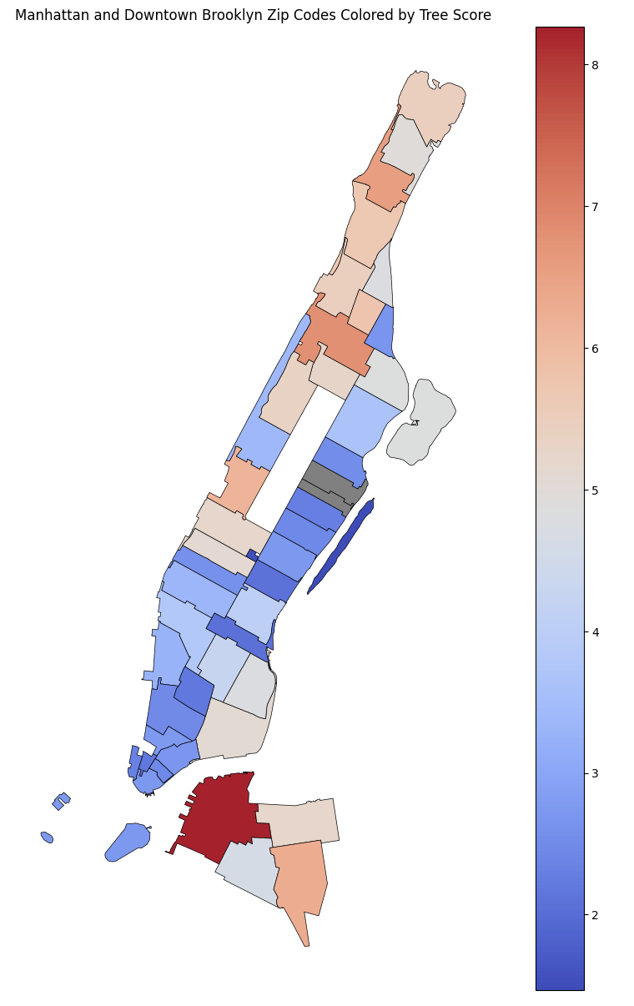
311-Score Heat Map

Slide 9
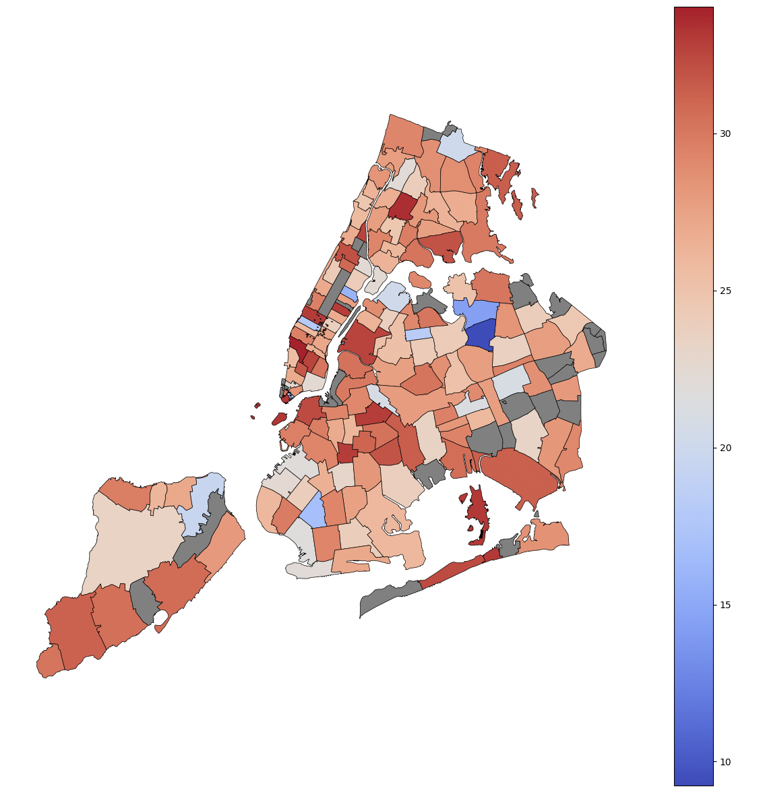
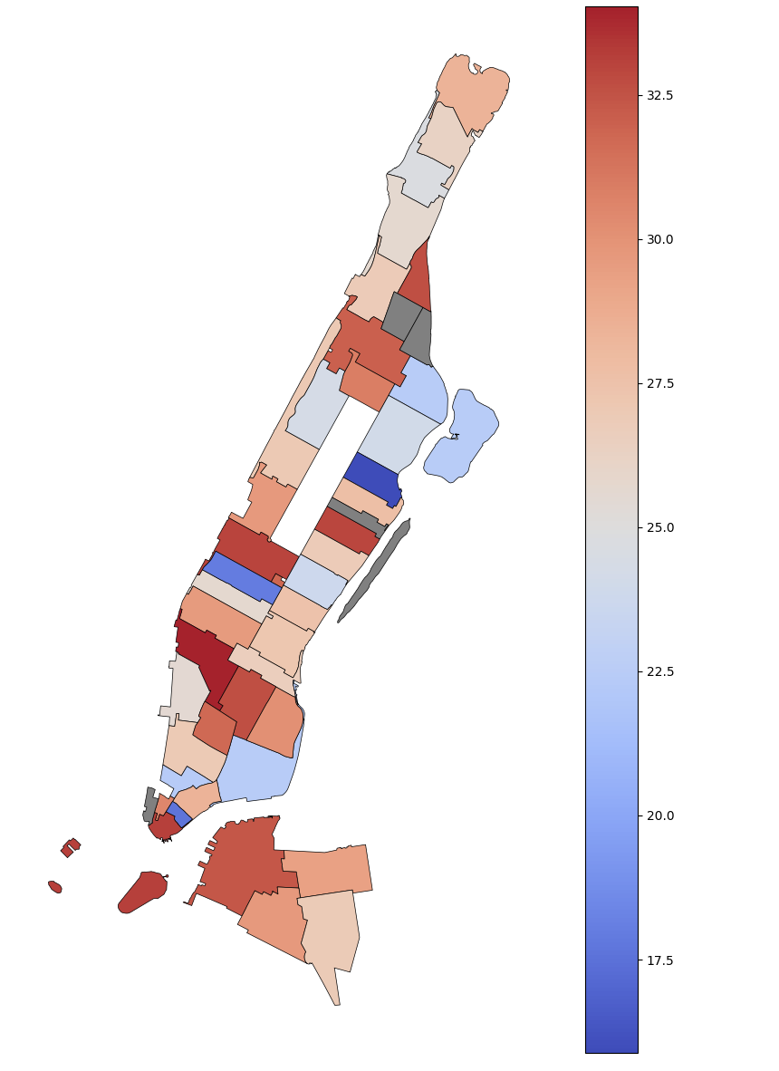
Aggregate-Score Heat Map
Notes:
weights to 70% for restaurants + 30% 311’s scaled by Treescores
if we had time we would normalize the data so it didnt look so much like everything is a good investment

Slide 10
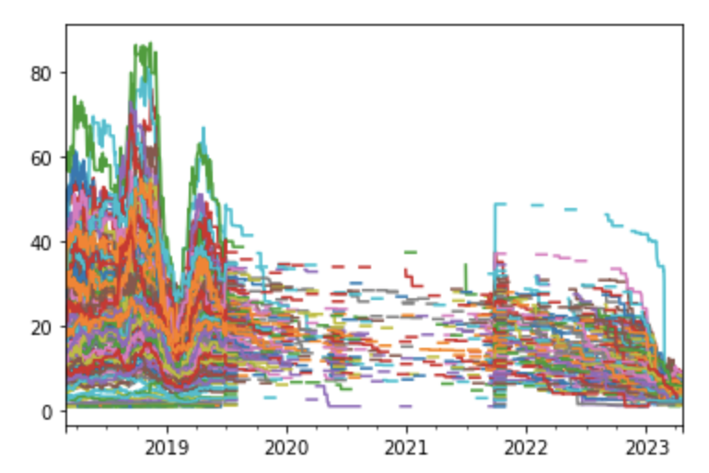
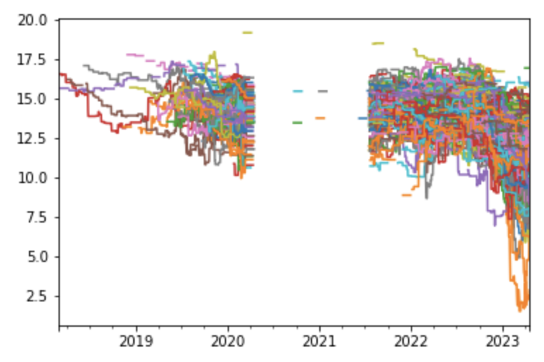
Time-Series of Components for Signal
311 Service Requests
Restaurant Inspections
Note: Lack of data for 311 requests & restaurants inspections during Covid had a major impact on the continuity of the signal. Also important to note that overall 311 claims have reduced since Covid

Slide 11
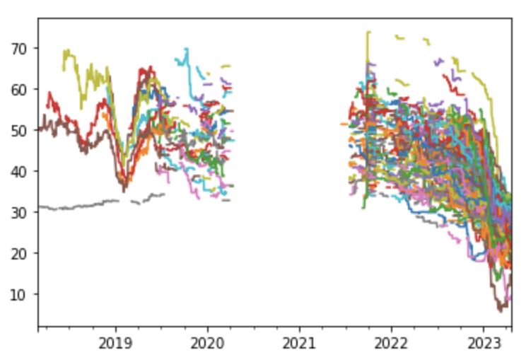
Time-Series of Final Signal Scores
Note: Lack of data for 311 requests & restaurants inspections during Covid had a major impact on the continuity of the signal. Also important to note that overall 311 claims have reduced since Covid

Slide 12
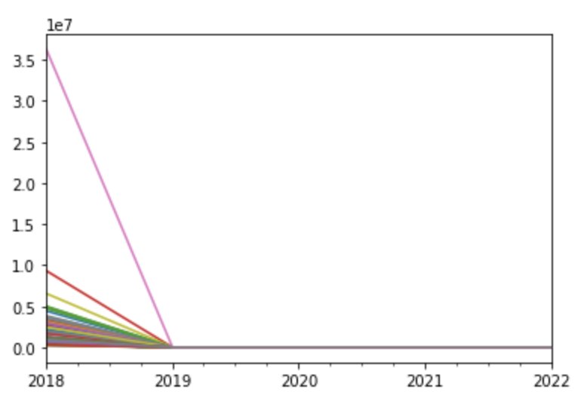
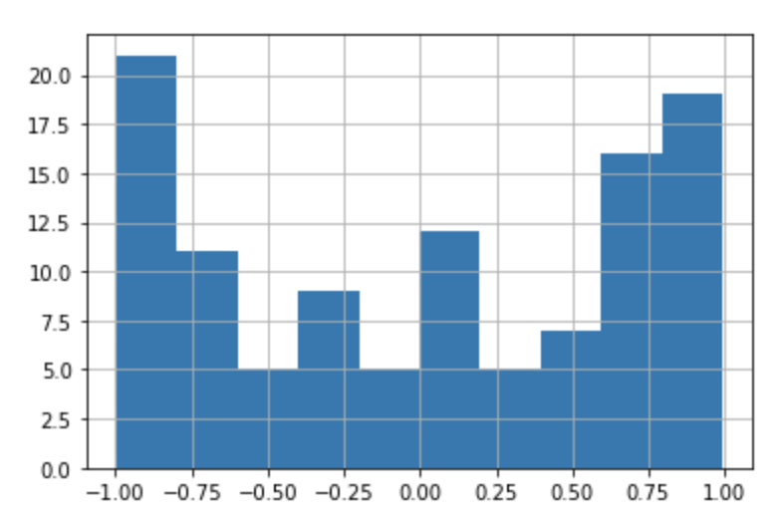
Signal Performance
%Δ YoY NYC Property Value by Zip
Correlation Prop-ValΔ & Signal Scores
Note: We only wanted to pull data from Open NYC Data and there is much better alpha metrics to analyze return on investment

Slide 13
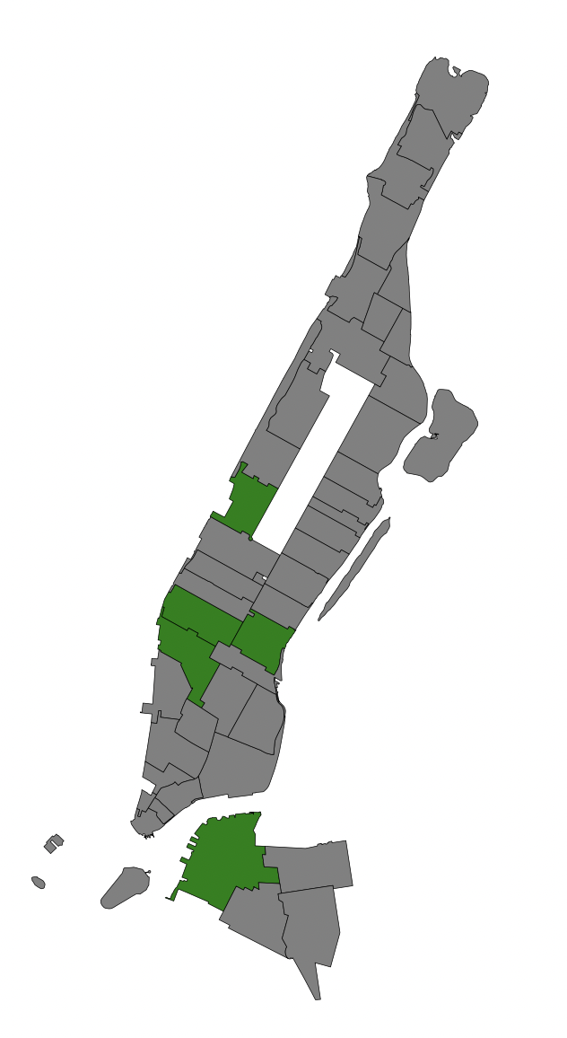
REIT Implementation of Signal
Current EQR developments
500 West 23rd Street -- 111 units (10011)
400 Park Avenue South -- 265 units (10026)
170 Amsterdam Avenue -- 230 units (10023)
Current AVB developments
West Chelsea -- 715 units (10001)
Avalon Willoughby Square -- 861 units (​​11201)
* SeekingAlpha: Residential REITs With Highest New York City Exposure (2012)
Notes:
REIT or real estate investment trust is basically an ETF for real estate investments
EQR has by far the largest portfolio -- just over 120,000 units -- out of the two REITs under discussion AVB
AVB has a portfolio of 53,000 apartments around the USA, with just under $118mm or 13% of gross rent generated from NYC. Turning our attention to AVB's development pipeline we see a robust future:

Slide 14
Before we take your money…
Biases
Lack of continuity in data through Covid-19 pandemic
Tree census data is outdated relative to the other two inputs
311 request frequency can be situationally misleading
Proof of Alpha
There is correlation, but are we beating the market?
Is the signal consistently accurate & profitable?
What are the capital requirements for employment?
Bottom Line:
We may have something here, but more rigorous back testing & risk analysis must be done before we can consider implementing this strategy.

